Slide 1
Year 6 SATs 2024 Presentation for Parents and Carers

Slide 2
What are the SATs?
SATs are the Standardised Assessment Tests that are given to children at the end of Key Stage 2.
The SATs take place over four days, starting on Monday 13th May ending on Thursday 16th May.
The SATs papers consist of:
Punctuation and grammar (paper 1) – Monday 13th May
Spelling (paper 2) – Monday 13th May
Reading – Tuesday 14th May
Maths (paper 1: Arithmetic) – Wednesday 15th May
Maths (paper 2: Reasoning) – Wednesday 15th May
Maths (paper 3: Reasoning) – Thursday 16th May
Writing is assessed using evidence collected throughout Year 6. There is no Year 6 SATs writing test.
The key stage 2 tests will be taken on set dates unless your child is absent, in which case they may be able to take them up to 5 school days afterwards.

Slide 3
When and how the SATs are completed
The tests take place during normal school hours, under exam conditions.
Children are not allowed to talk to each other from the moment the assessments are handed out until they are collected at the end of the test.
After the tests are completed, the papers are sent away to be marked externally.
The results are then sent to the school in July.
Each test lasts no longer than 60 minutes:
Punctuation and grammar (paper 1) – 45 minutes
Spelling (paper 2) – 15 minutes
Reading – 60 minutes
Maths (paper 1: Arithmetic) – 30 minutes
Maths (paper 2: Reasoning) – 40 minutes
Maths (paper 3: Reasoning) – 40 minutes

Slide 4
Specific arrangements for SATs
Some children with additional needs (who have similar support as part of day-to-day learning in school) may be allotted specific arrangements.

Slide 5
The results
Tests are marked externally. Once marked, the tests will be given the following scores:
A raw score (total number of marks achieved for each paper);
A scaled score (see below);
A judgement on if the National Standard has been met.
After marking each test, the external marker will convert the raw score to a scaled score. Even though the tests are made to the same standard each year, the questions must be different. This means the difficulty of the tests may vary. Scaled scores ensures an accurate comparison of performance over time.
Scaled scores range from 80 to 120.
A scaled score of 100 or more shows the pupil is meeting the National Standard.

Slide 6
Spelling, Punctuation and Grammar
Spelling, Punctuation and Grammar consists of two papers.
Paper 1 focuses on all three elements (spelling, punctuation and grammar). The paper lasts for 45 minutes.
Paper 2 consists of a spelling test only. It should take approximately 15 minutes, although this is not a set amount of time (pupils should be given as much time as they need to complete the test).

Slide 7
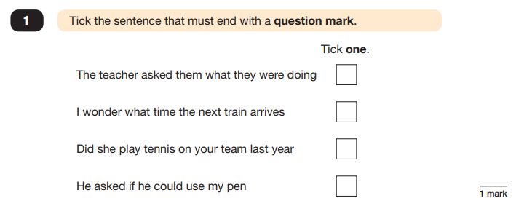
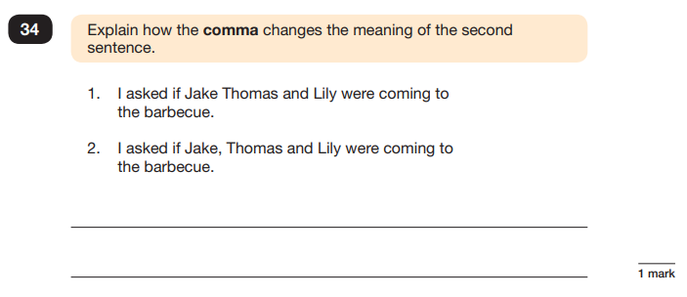
Spelling, Punctuation and Grammar: Paper 1
Example questions:
e.g. that, which
✔
e.g. The first sentence is about two people and the second sentence is about three people.

Slide 8
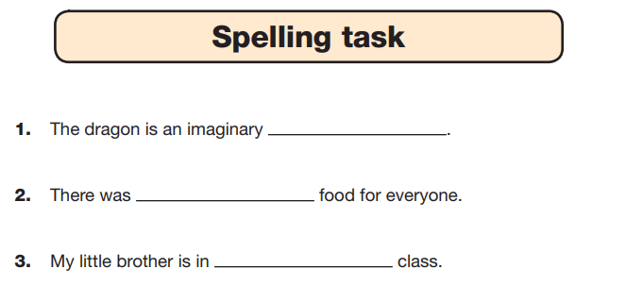
Spelling, Punctuation and Grammar: Paper 2
Paper 2 is a shorter paper that focuses solely on spellings.
Example questions:

Slide 9
Reading
There is one reading test that lasts for 60 minutes.
The test is designed to measure if the children’s comprehension of age-appropriate reading material meets the national standard. There are three different set texts for children to read. These could be any combination of non-fiction, fiction and/ or poetry.

Slide 10
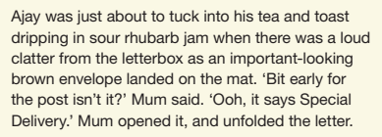
Reading
The reading SATs paper requires a range of answer styles.
Example questions:

Slide 11
Maths
The maths assessments consist of three tests.
Paper 1: Arithmetic (30 minutes)
Paper 2: Reasoning (40 minutes)
Paper 3: Reasoning (40 minutes)

Slide 12
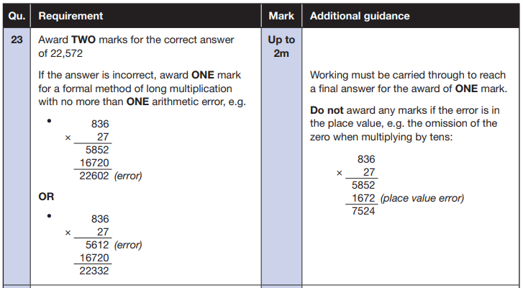
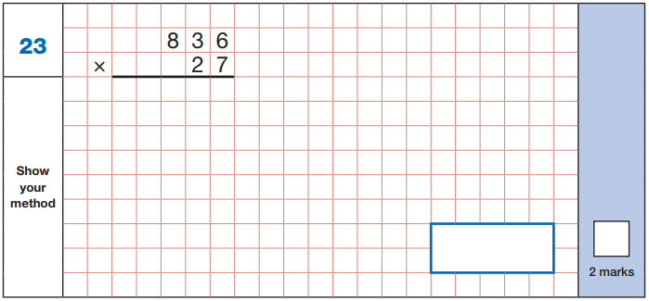
Maths Paper 1 (Arithmetic)
The test covers the four operations (addition, subtraction, multiplication, division, including order of operations requiring BIDMAS), percentages of amounts and calculating with decimals and fractions.
Example question:

Slide 13
Maths Papers 2 and 3 (Reasoning)
These papers require children to demonstrate their mathematical knowledge and skills, as well as their ability to solve problems and their mathematical reasoning.

Slide 14
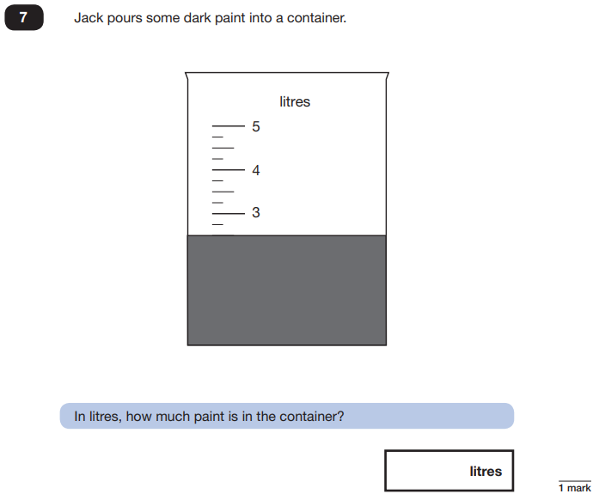
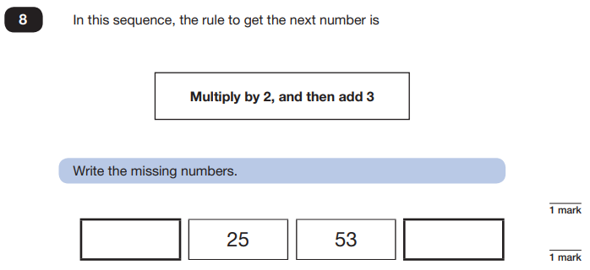
Maths Papers 2 (Reasoning)
Example questions:
11
109
2.5 or 2 ½

Slide 15
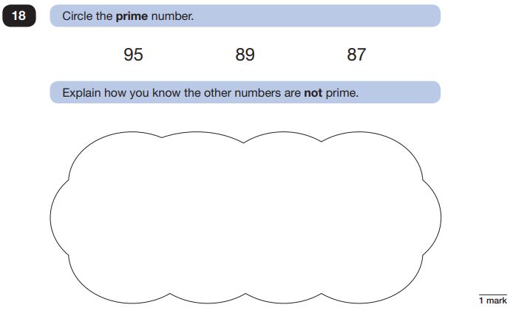
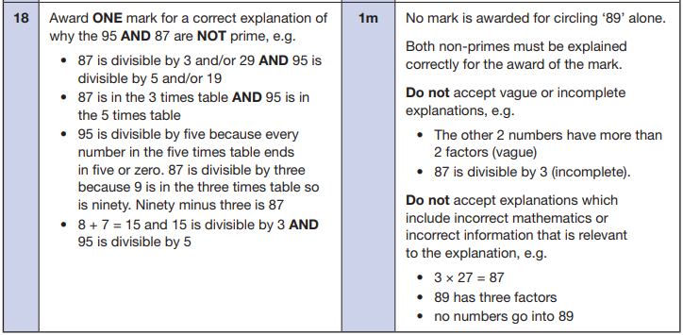
Maths Papers 2 (Reasoning)
Example question:

Slide 16
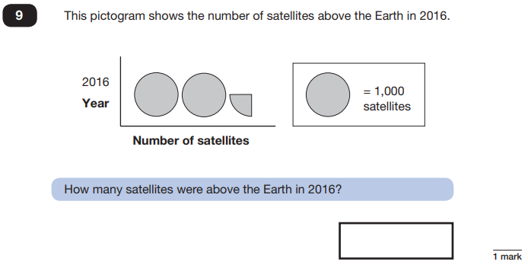
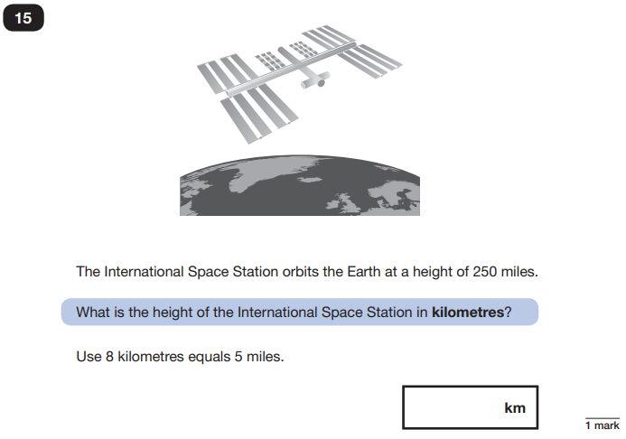
Maths Papers 3 (Reasoning)
Example questions:
2,250
400

Slide 17
Things to remember about SATs
SATs focus on what children know about Maths and English.
They will not reflect how talented they are at science, geography, art, PE…, and they certainly won’t highlight all of their amazing personal characteristics.
SATs don’t tell the whole story.
Their results will say if they did or did not meet a certain standard but not necessarily by what margin. These thresholds change each year according to the overall national performance, so what was classed as ‘meeting the expected standard’ this year might not be the same as last year.
SATs are only four days out of a whole Primary School career.
In reality, there’s one or two papers each day that last 30 to 60 minutes.

Slide 18
What else?
SATS Breakfast – children can come into school from 8:30am
Rest/breaks
Routine
Curriculum
Celebration
Slippers – children can bring in their slippers to complete their assessments if they wish

Slide 19
For support during SATs week, please visit this week for hints and tips.
https://thirdspacelearning.com/blog/sats-mental-wellbeing/

Slide 20
Any questions?

