Slide 1
Class 4 Residential
Monday 20th – Wednesday 22nd

Slide 2
Staff members
Mr Fry
Miss McCormick

Slide 3
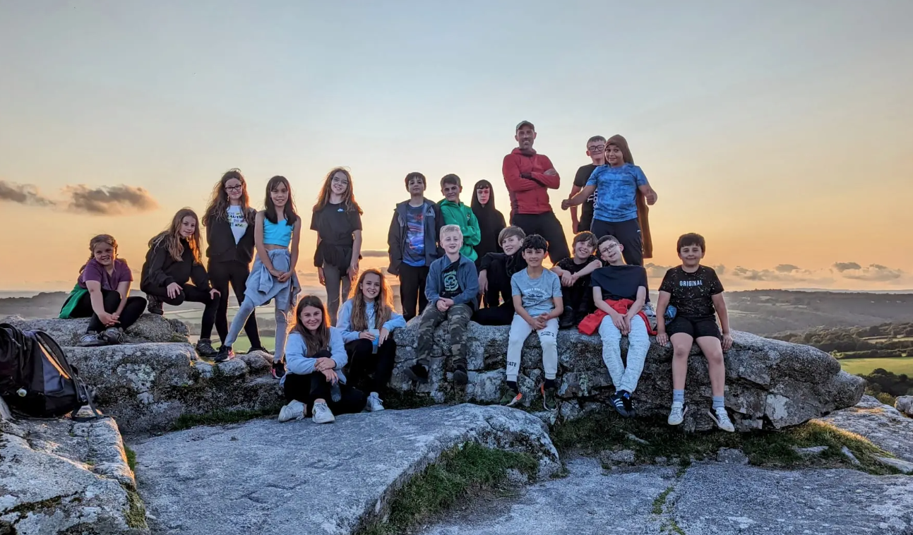
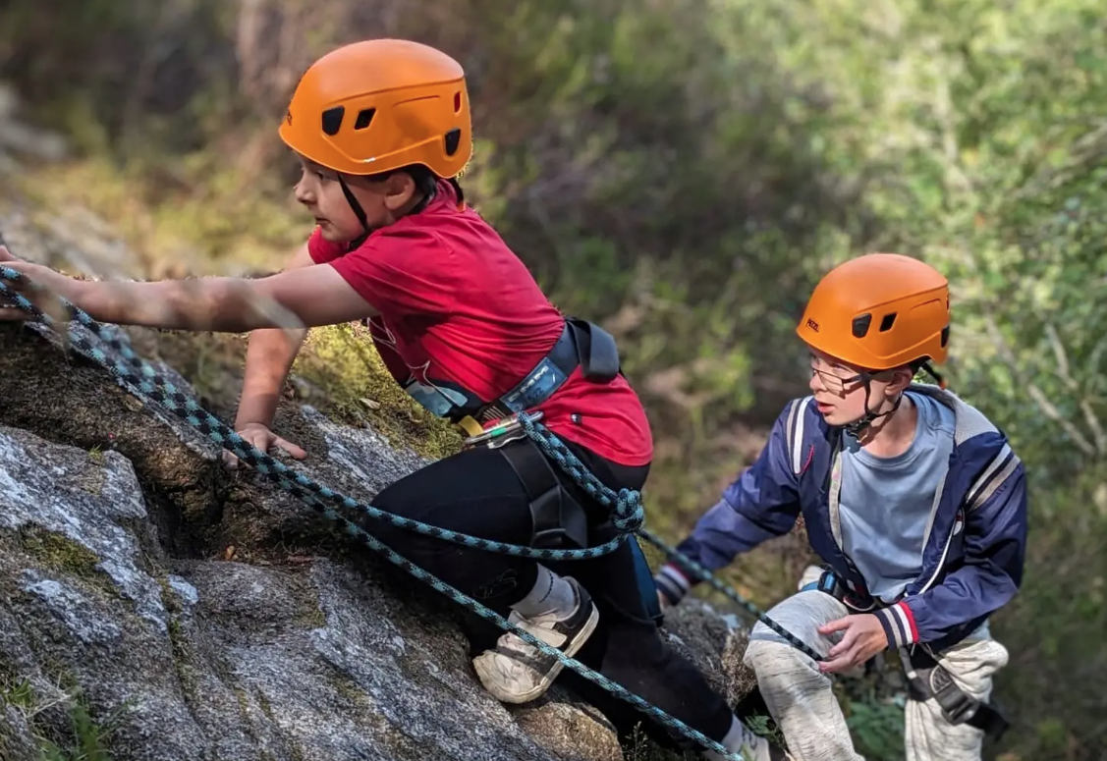
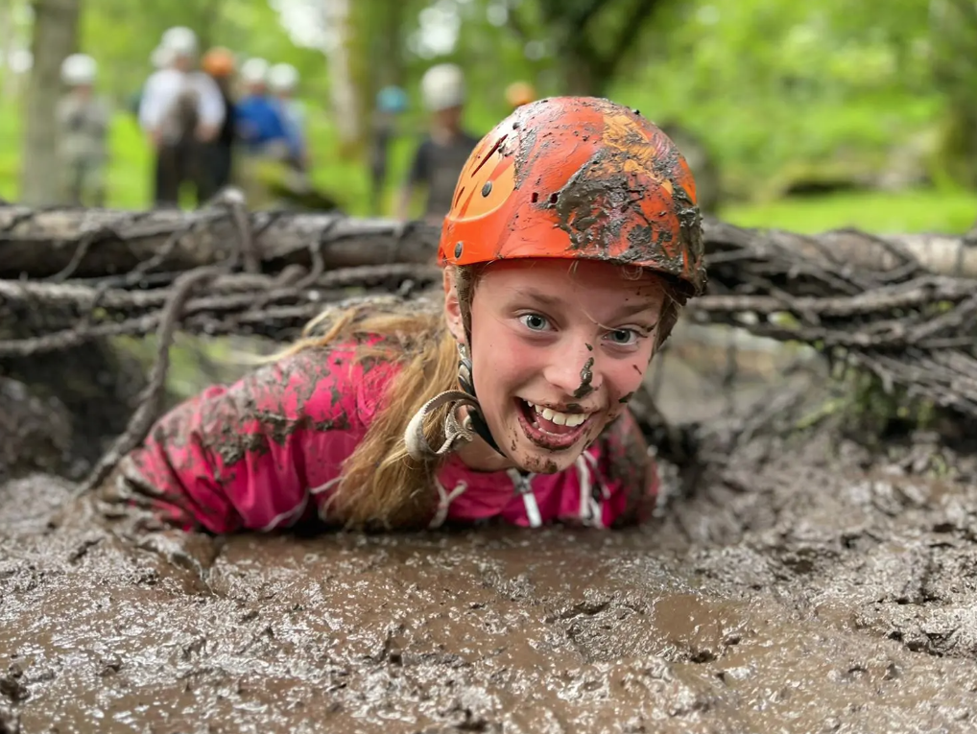
Spirit of Adventure, Dartmoor

Slide 4
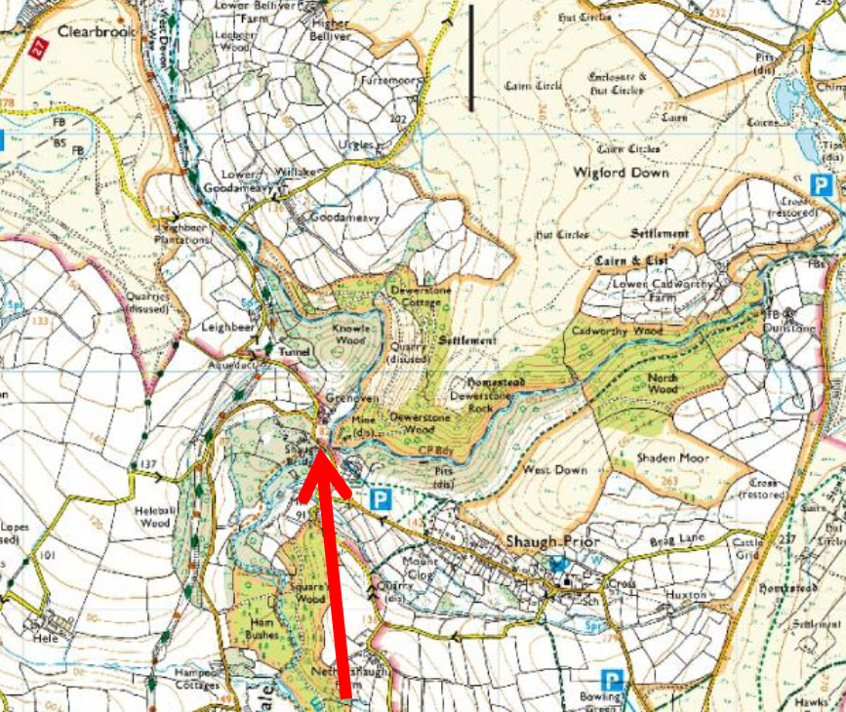
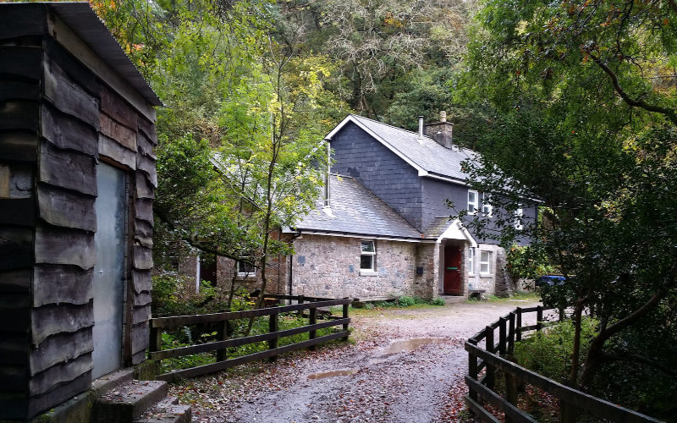
Where is it?
Dewerstone, Dartmoor

Slide 5
Dewerstone Adventure Race
https://www.spirit-of-adventure.com/schools/teachers/residentials/dewerstone-adventure-race/

Slide 6
Departure
Children will need to arrive at Georgeham Village Hall at 7:45am with their bags.
The children will come to the village hall in the clothes they will travel in – not school uniform.
We will be leaving at 8:30am.
Please bring a packed lunch for the first day.
Please ensure that you have completed the medical form and have returned it school before departure.

Slide 7
Activities
Pioneering and construction skills
Navigation and orienteering skills
Outdoor cookery
Climbing and abseiling skills
River and waterfall scramble
Dewar’s Challenge, adventure race.

Slide 8
Day 1
10:30 Arrival and transfer to Dewerstone Cottage
10:40 Briefing and settle in
11:15 Orienteering session
12:15 Lunch and Group Activities
13:00 - 16:30 Let the adventure begin!
18:00 Tea time
22:00 Bed

Slide 9
Day 2
07:30 Breakfast
09:00 Prepare packed lunches
10:00 Rock skills, a full day of rock base activities.
16:00 Outdoor cookery - Use of the field kitchen or open fires to create a delicious evening meal.
19:00 Free time and entertainment.
21:30 Bed time drink and biscuit.
22:00 Bed.

Slide 10
Day 3
07:30 Breakfast.
09:00am Briefing for the Dewar’s Challenge adventure race.
10:00am Adventure Race!
14:30 Depart

Slide 11
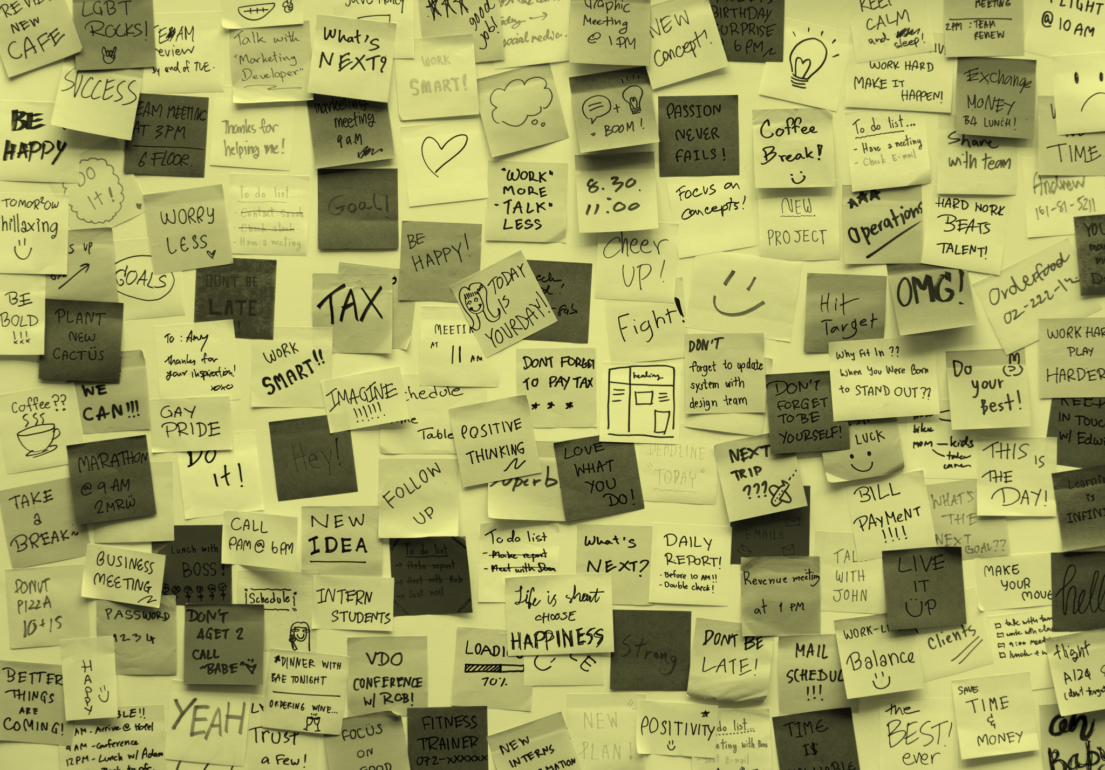
Return
We will be back on Wednesday afternoon for parents/carers to collect their children at approximately 16.30 (depends on traffic!) from the Georgeham Village Hall
If we are going to be significantly late, we will let you know via text message
We will ring the school office daily, and post regular updates on twitter @GeorgehamCEPS and a daily text message to parents

Slide 12
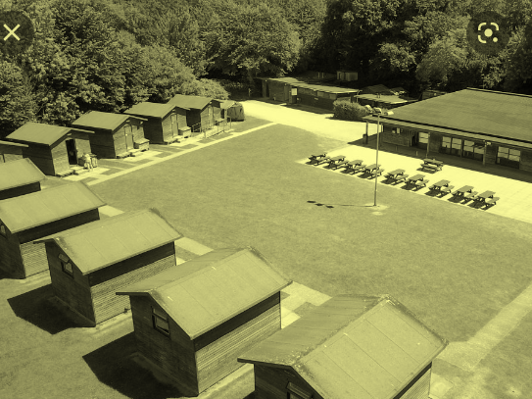
FOOD
We are provided three meals per day.
Dietary requirements and allergies have all been sent.
Children to bring a packed lunch on the first day

Slide 13
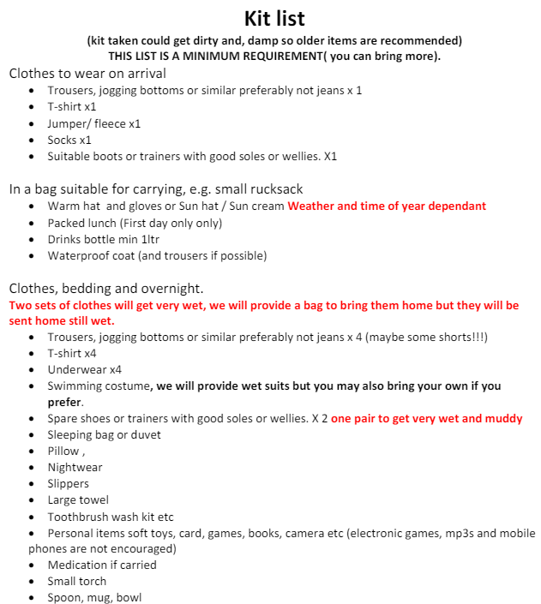
What can they take?

Slide 14
Medicine
Mr Fry and Miss McCormick will collect any medicine (including vitamins and travel sickness pills).
They must be clearly labelled and signed in and out.
Administering form must be completed and discussed with medical officer before dropping off.
Anything administered will be witnessed and recorded.
Parents must collect and sign for medication on return.
Please ensure your current contact details have been included on the medical form

Slide 15
Anything that you still need to know…?

